Slide 1
Build a Native Android Application out of HTML, JavaScript and CSS
Russell Schwager
@rschwager

Slide 2


Millennial Media’s Platform
More than 60,000 apps
170MM monthly unique U.S. users
650MM monthly unique worldwide users
Approximately 9,000 devices
90 of the 100 Top Ad Age advertisers
All metrics are as of May 8, 2014
Insights & Creative Performance insights and industry-leading creative development
Global Footprint Reach mobile users in nearly every country in the world

Slide 3


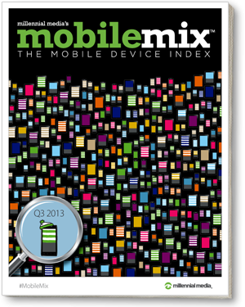
Reporting & support tools
Reporting & Insights
Make informed, data-driven business decisions
Access metrics including requests, views, fill rate, CTR and more
Monitor revenue earned from advertising
Resources & Support
Unparalleled customer support services
Informative Resource Center
Unbiased industry research and insights delivered through S.M.A.R.T. and Mobile Mix reports
Looking for tech support help with creating an account, downloading our SDK or any other question?
Email: support@millennialmedia.com

Slide 4




Promote your apps with mMedia
mMedia, our self-service advertising tool, helps you manage your campaigns from start to finish
Conversion tracking capabilities help you track, analyze, and optimize app installs
Use our creative gallery to upload, create and organize your mobile banner ads
Reinvest money earned monetizing your app to help grow your user base
Drive downloads and gain more users with highly-targeted ads
Device Targeting
Reach desired OS and devices
Audience Targeting
Specify location, gender and age
Carrier Targeting
Run on specific mobile carriers
Site Optimization
Target the most effective sites/apps

Slide 5
What are “Chrome Apps”
Chrome Apps deliver an experience as capable as a native app, but as safe as a web page. Just like web apps, Chrome Apps are written in HTML5, JavaScript, and CSS. But Chrome Apps look and behave like native apps, and they have native-like capabilities that are much more powerful than those available to web apps.

Slide 6
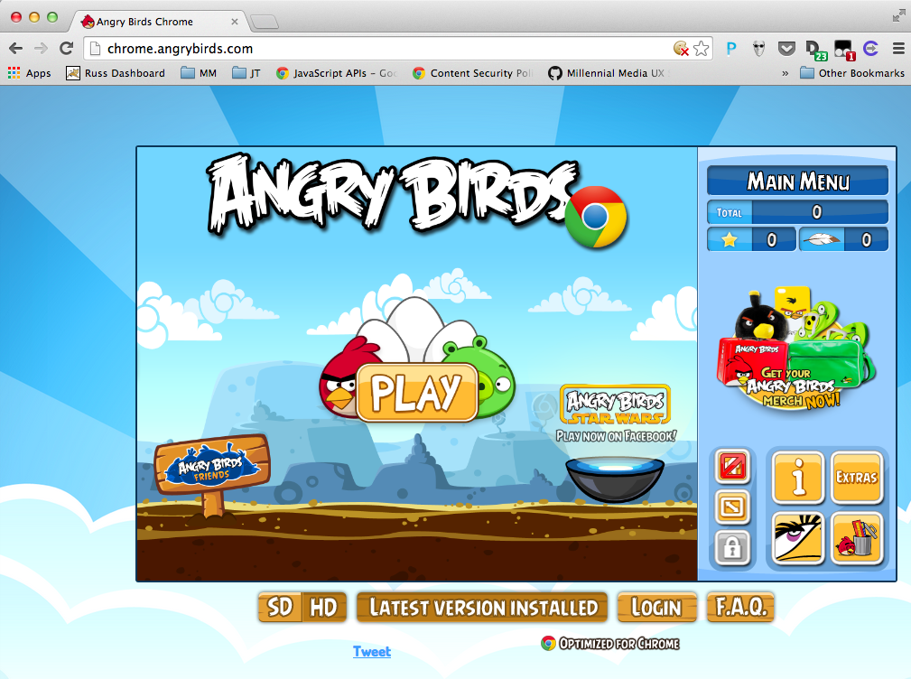
Example Chrome App

Slide 7
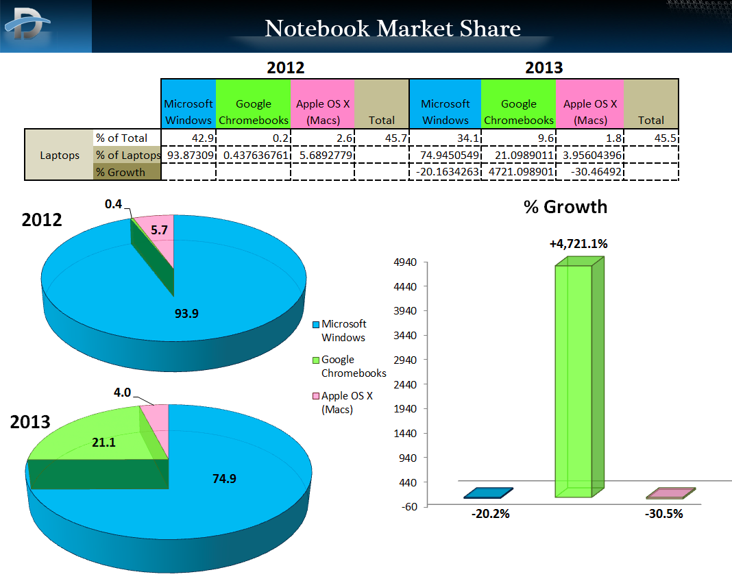
Source: http://www.dailytech.com/Chromebooks+Capture+21+Percent+of+2013+US+Notebook+Sales/article33985.htm

Slide 8
Chrome App Stack
Apache Cordova
HTML
Javascript
CSS
Chrome Security Model
Chome API and Services
App Container

Slide 9
App Security Model
https://developer.chrome.com/apps/contentSecurityPolicy
You can’t use inline scripting in your Chrome App pages. The restriction bans both <script> blocks and event handlers (<button onclick="...">).
You can’t reference any external resources in any of your app files (except for video and audio resources). You can’t embed external resources in an iframe.
You can fetch remote resources via XMLHttpRequest and serve them via blob:, data:, or filesystem: URLs
You can’t use string-to-JavaScript methods like eval() and new Function().

Slide 10
Chrome API and Services – Support on Mobile
https://developer.chrome.com/apps/api_index
alarms - Android and iOS
fileSystem - Android and iOS
i18n - Only some methods are supports
identity - Android and iOS
idle - Android and iOS
notifications - Android only
power - Android and iOS
pushMessaging - Beta quality on Android and iOS.
socket - Android and iOS.
storage - Android and iOS.
syncFileSystem - Beta quality on Android and iOS

Slide 11
Chrome Services and APIs - Not supported on Mobile
https://github.com/MobileChromeApps/mobile-chrome-apps/blob/master/docs/APIStatus.md
bluetooth
commands
contextMenus
mediaGalleries
permissions
serial
systemInfo.cpu
systemInfo.display
systemInfo.memory
systemInfo.storage
tts
types
usb
webstore
<webview> tag
NaCl

Slide 12
Building your own - Prerequisites
https://github.com/MobileChromeApps/mobile-chrome-apps/blob/master/docs/Installation.md
Node.js
For Android Development
Java 7 JDK
Android SDK
Apache Ant
The cca command line tool
npm install –g cca
cca checkenv

Slide 13
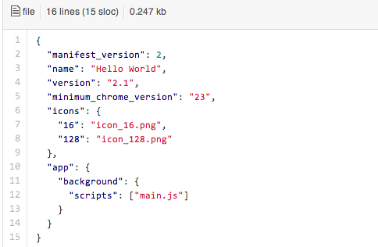
“Hello World!” – Manifest.json

Slide 14
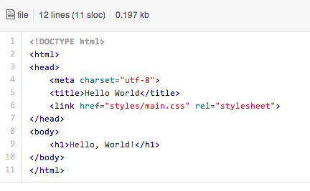
“Hello World!” – index.html

Slide 15
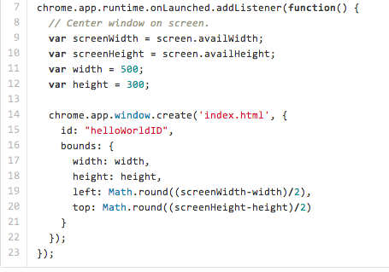
“Hello World!” – main.js

Slide 16
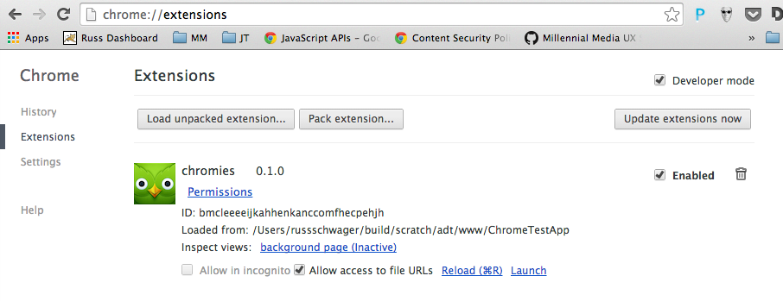
Testing and Debugging
Use Chrome Developer Tools!

Slide 17
Debugging on the Device/Emulator
https://github.com/MobileChromeApps/mobile-chrome-apps/blob/master/docs/Develop.md
Using the cca command line tool:
To run your app on the Android Emulator: cca emulate android
Note: This requires that you've set up an emulator. You can run android avd to set this up. Download additional emulator images by running android. To make the intel images run faster, install Intel's HAXM.
To run your app on a connected Android device: cca run android
Debugging on the device using developer tools
See https://developer.chrome.com/devtools/docs/remote-debugging

Slide 18
More information
Millennial Media: http://www.millennialmedia.com
My sample app: https://github.com/rschwager/andevcon-sample
Chrome Mobile Apps Documentation and Samples: https://github.com/MobileChromeApps/mobile-chrome-apps
Chrome Web Apps Samples: https://github.com/GoogleChrome/chrome-app-samples

Slide 19
Thank you

